Slide 1
Git & Github

Slide 2


Git
Github
VCS - Version Control System
A version control system (VCS) tracks changes to files, allowing developers to collaborate and return to earlier versions
Git is a type of VCS
A website that allows developers to store and manage their code using Git.
https://github.com

Slide 3
Setting and Configuring Git
Configuring Git
Download Git From - https://git-scm.com/downloads
Verifying Git Installation :
git --version
git config --global user.name "Your Name"
git config --global user.email "your@email.com"
git config --list

Slide 4
Clone and Status
Clone - Cloning a repository on our local machine
git clone < git repo link>
Status - Display the status of the code
git status

Slide 5
Add and Commit
Add - adds new or changed file in your working directory to the Git staging area
git add < file name >
Commit - It is the record of change
git commit -m “some message”

Slide 6
Push Command
Init Command
Push - upload local repo content to the remote repo
git push origin main
Init - used to initialize or create a new repository.
git init

Slide 7
Remote Repository
git remote add origin is a command used to link your local Git repository to a remote repository in Github.
It tells Git where to push your changes or pull updates from.
git remote add origin <repo link>
To Verify the remote repo
git remote -v

Slide 8
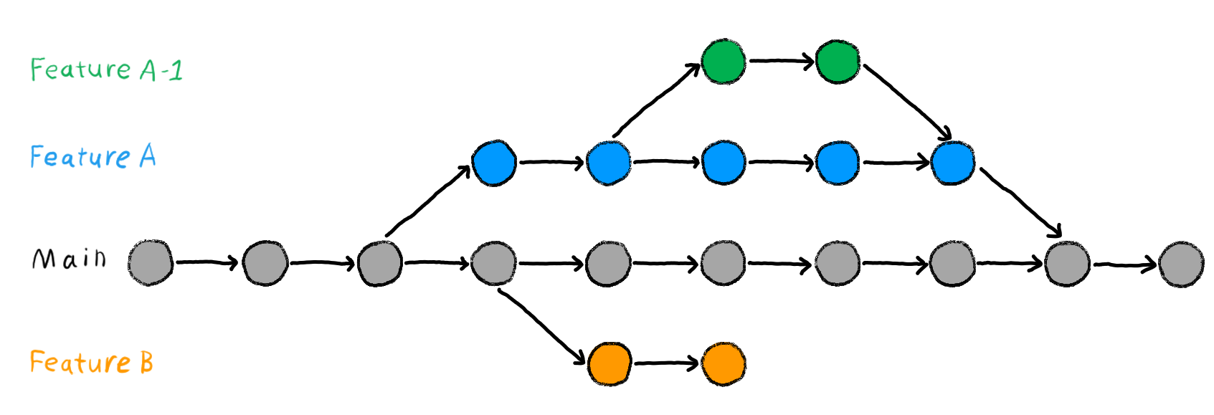
Git Branch
In Git, a branch is a new/separate version of the main repository.
Git branch is like a "copy" of your project where you can make changes without affecting the main project.

Slide 9
Git Branch Commands
git branch -> to check the current branch
git branch <branch name> -> to create a branch
git branch -M <branch name> -> rename the current branch
git checkout <branch name> -> to navigate to another branch
git branch -d <branch name> -> to delete a branch
git diff - helps you see, compare, and understand changes in your project
git log - log reports

Slide 10
Pull Command
The git pull command is used to fetch and download content from a remote repository and immediately update the local repository to match that content
git pull origin main

Slide 11
Git Reset
Soft reset:
Moves your last commit back, but keeps your changes in the working directory and staged for commit.
It’s like undoing a commit but still keeping all the work you did.
git reset --soft
Hard reset:
Moves your last commit back and erases all changes (both from the working directory and staging area).
It’s like completely forgetting about your changes and going back to the state of a previous commit.
git reset --hard

Slide 12
Thank You

